Slide 2
Email Server Configuration and Customization (Scimail)
Minor - I
Mid-Term Presentation
on
Project Guide
Dr. Monit Kapoor
Associate Professor,
Head of Department,
School of Computer Science (Department of Cybernetics)

Slide 3
Motivation
SECURITY CONCERNS
Emails have become a greater part of our lives. The Email, one organized well, is the most effective means of communication for business. A lot of companies nowadays have their privacy factors, in which they prefer to keep their delicate data inside their organizations.
RELIABLE MODE OF COMMUNICATION
The customization done in the project are on the requirements that are generally required by the company to establish a smooth and reliable medium of communication with restriction of messages like maintaining the buffer log, automating the mail server to generate automatic backups, providing special restriction to unaccepted contents and to make the data searchable and easily accessible.

Slide 4
Objective
The Perform Customization of an email server to serve as per the constraints identified for an organization:
To inspect sensitive content in the mail and add constraints respective to it.
Maintain a log of all sensitive emails from the server.
To automate the process of Backup and deletion of logs.
Applying searching and sorting algorithm to buffer list for easy access.
Filtering the content and providing the security to the process by signing SSL, TSL Certifications.

Slide 5
Objectives achieved so far
Pilot POC of the code with architecture, rollback and all the binaries.
Implemented filtering of mail based on sensitive content, and if a mail contains sensitive content then the mail is marked as flagged and logs of such mail are maintained for administration purposes.
Designed a completely scripted package that provides the user with a UI (Java AWT) to send mail via postfix and in the backend, it inspects the mail for any sensitive content and thus performs filtration process.
Admin panel is designed which requires authorization. After access granted, it gives ability to admin to view all mail logs, sensitive logs, buffer emails, view/edit dictionary, control postfix services, and handle SSL certifications.
Implemented cron jobs to automate the process of creation of compressed files out of buffer directory as backup and logs removal every month due to security and concerns.

Slide 6
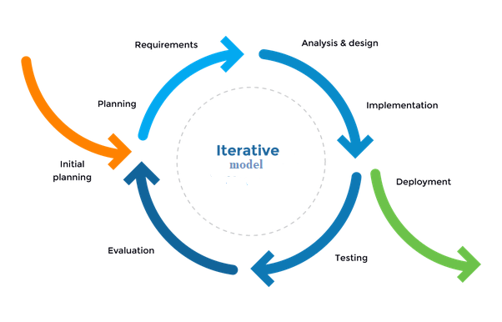
Methodology (i)
Iterative model
Fig 1: Iterative Model

Slide 7
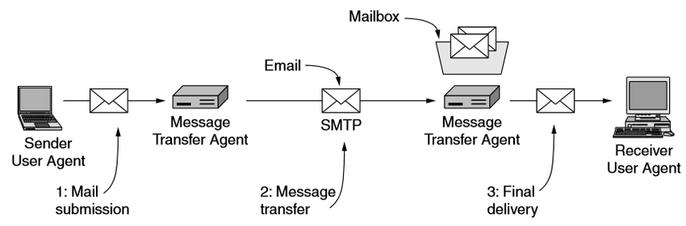
Methodology (ii)
Email Architecture
Fig 2: Email Architecture

Slide 8
Filtering of mails
In every organization, some privacy factors are needed to be followed by the employees. (Here privacy factors refers to any sensitive information related to the organization or some other purposes which must always remain in the organization itself).Even the employees must never use such a language which may lead to having issues in inter-organization or intra-organization.
Email is the primary source of communication in intra-organization or inter-organization. Thus every organization must have their email servers customized in such a way that the emails sent by their employees must be always filtered so that they get to know if any employee is breaking the boundaries.
Filtering of email is done on its content and is based on the resources (i.e. files which tells what is the sensitive content that should not be used in email).
The resource files are needed to be maintained and updated by the organization on regular intervals.

Slide 9
SCIMAIL
Scimail is the name which we have given to our scripted package , which when executed performs various code such as java AWT code for UI interface and C code providing functionality for filtering of mail based on sensitive content, and thus makes it all possible by running just one command in the shell.
The codes executed after running this shell command also sends mail using postfix and in the backend filtering is performed on the sent mail and so the backup of flagged mails (i.e. mails with sensitive content) is maintained.

Slide 10
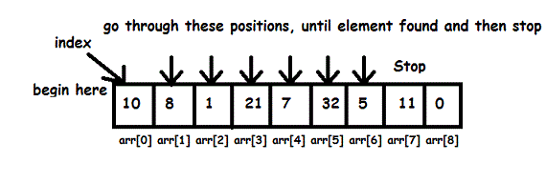
Algorithm
INTERIM ALGORITHM
In our project, we are using linear search algorithm to compare the values between two different files, i.e. the mail file (containing the entered values by the client for sending of mail) and the dictionary (containing the sensitive word).
If any string or value in dictionary is in the mail content then the mail is having sensitive content and it is then flagged for administration purposes.

Slide 11
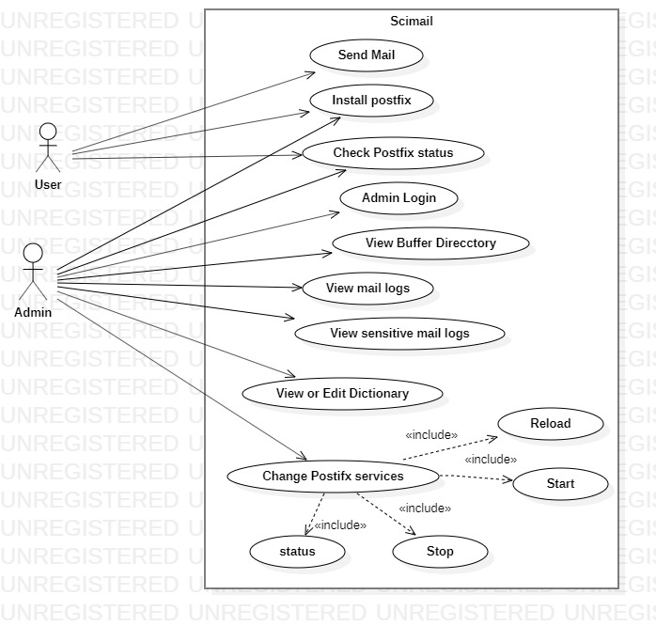
USE CASE DIAGRAM

Slide 12
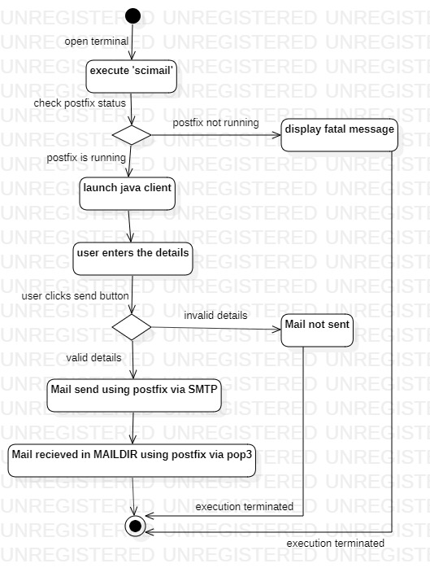
ACTIVITY DIAGRAM (SCIMAIL)

Slide 13
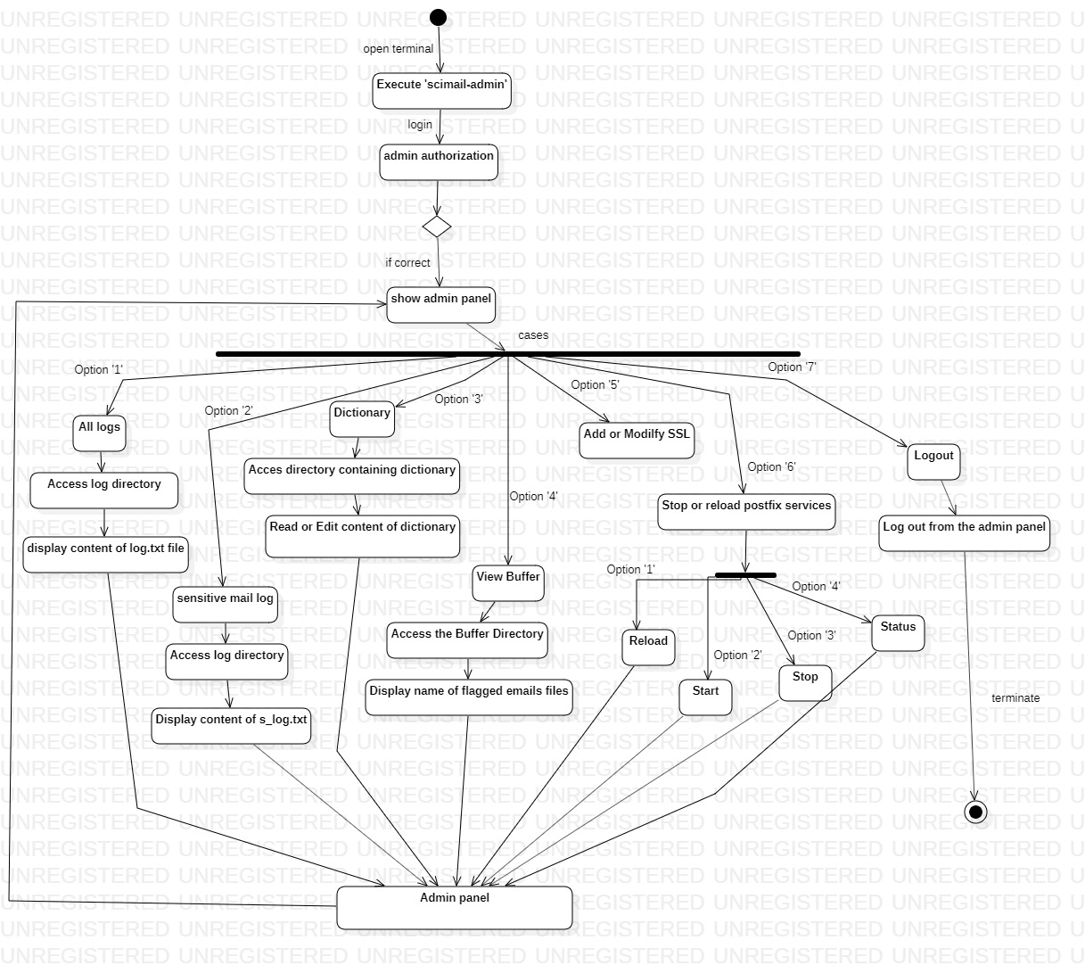
ACTIVITY DIAGRAM (SCIMAIL-ADMIN)

Slide 14
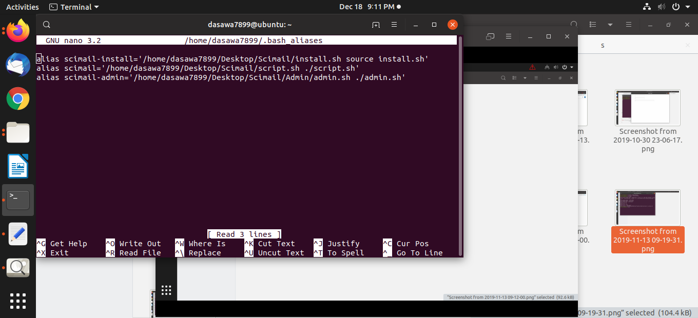
SCIMAIL WORKFLOW
Fig 1: Editing of bash_alias file

Slide 15
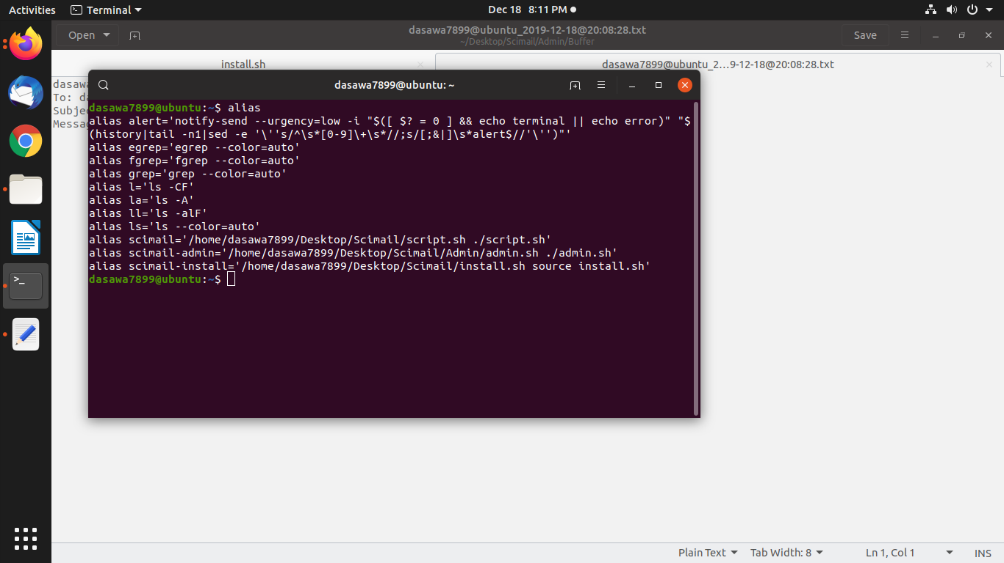
Fig 2: Setting of alias named ‘scimail’, ‘scimail-admin’, and ‘scimail-intall’

Slide 16
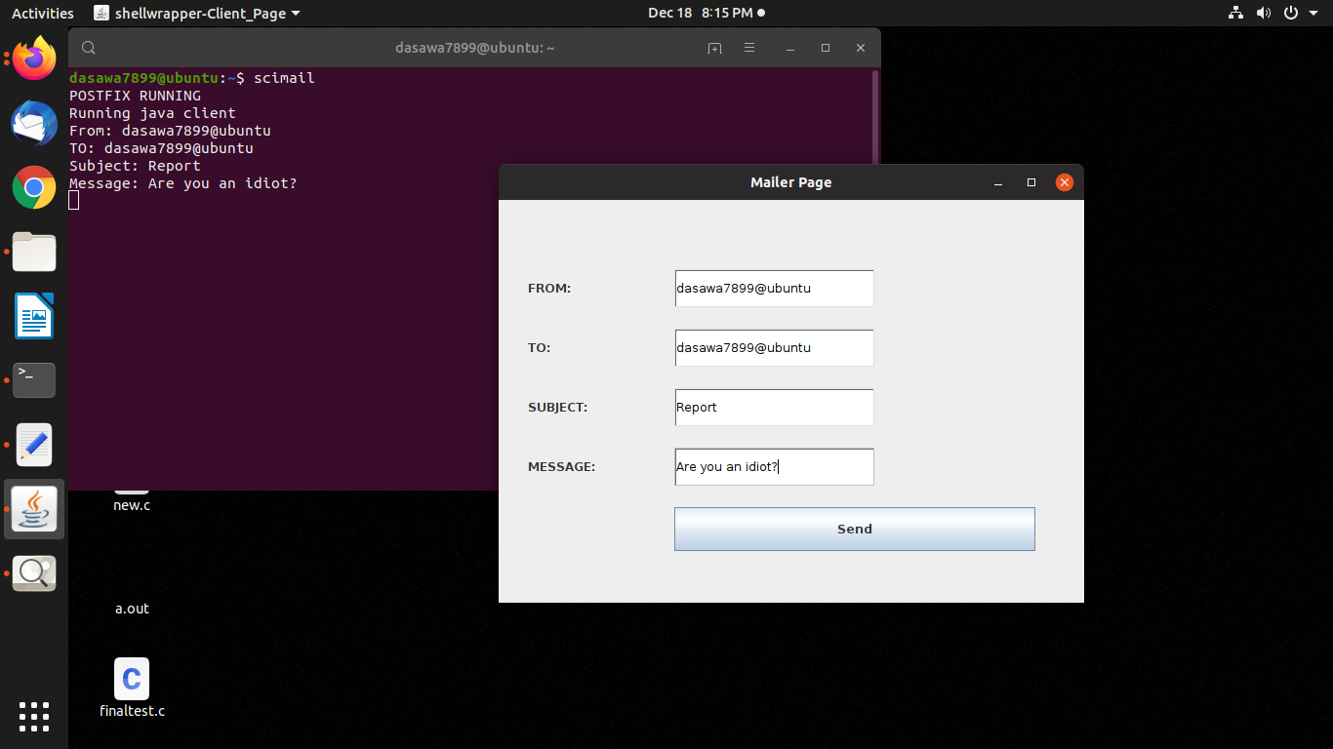
Sample Mail 1: Mail with sensitive content
Fig 3: Execution of scimail command and java awt client for mail content

Slide 17
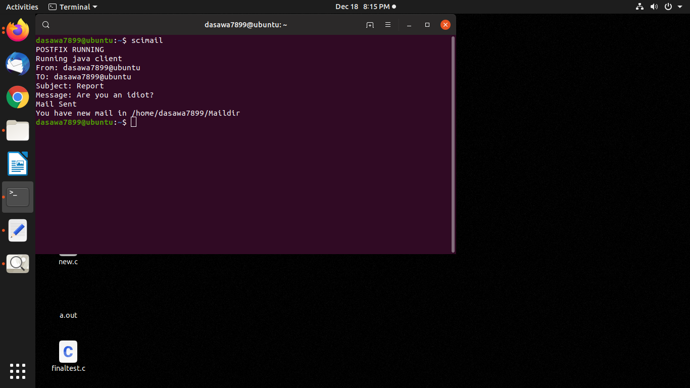
Fig 4: Mail sent via postfix (using SMTP)

Slide 18
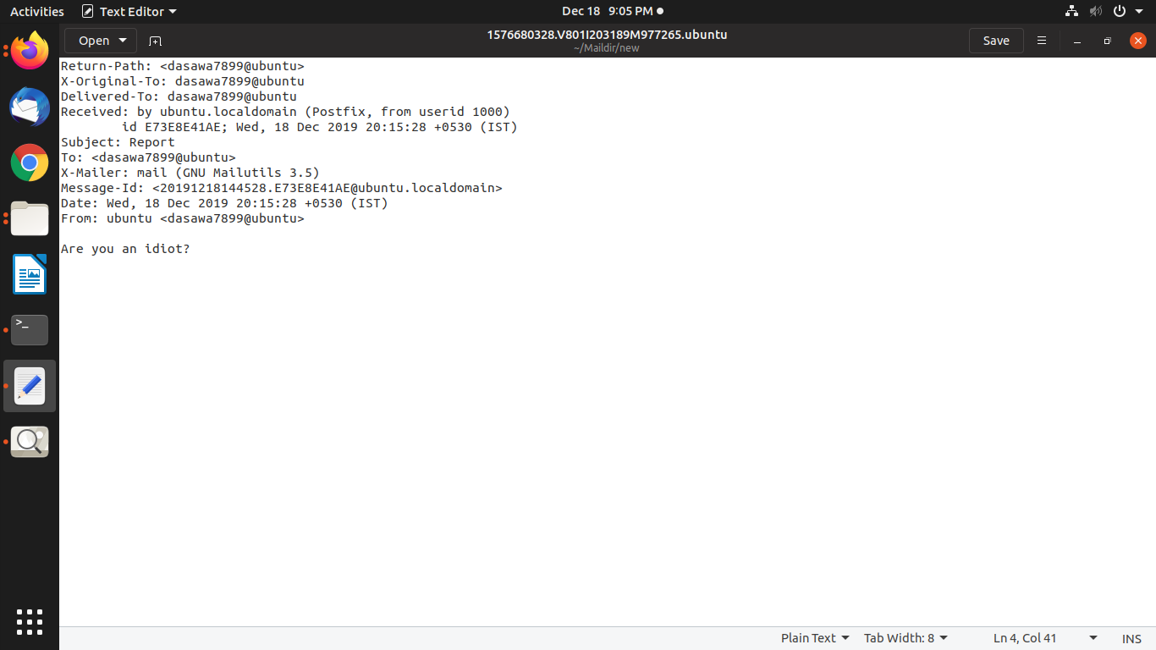
Fig 5: Mail received in Maildir using Postfix via POP3

Slide 19
Fig 6: Sensitive content found, new file create in buffer directory

Slide 20
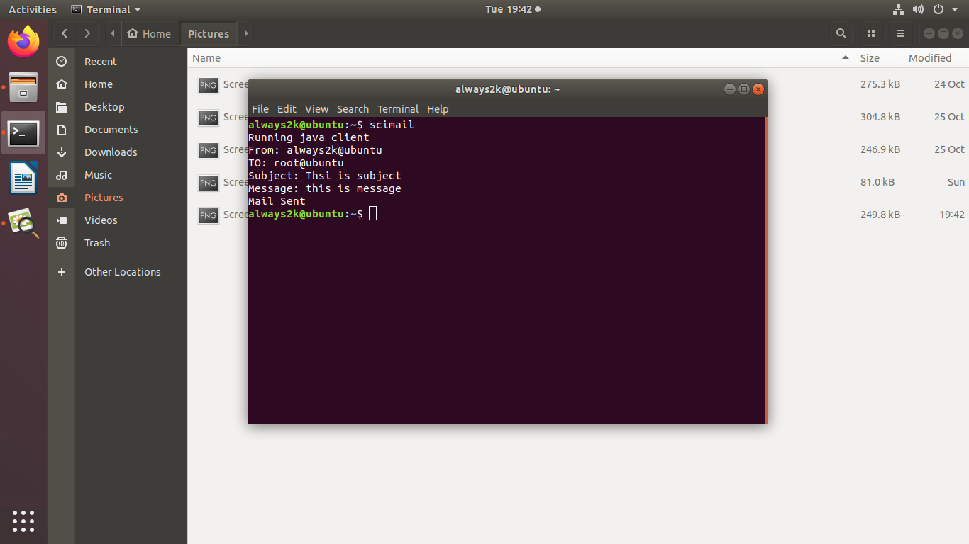
Sample Mail 2: Mail without sensitive content
Fig 7: Execution of scimail command

Slide 21
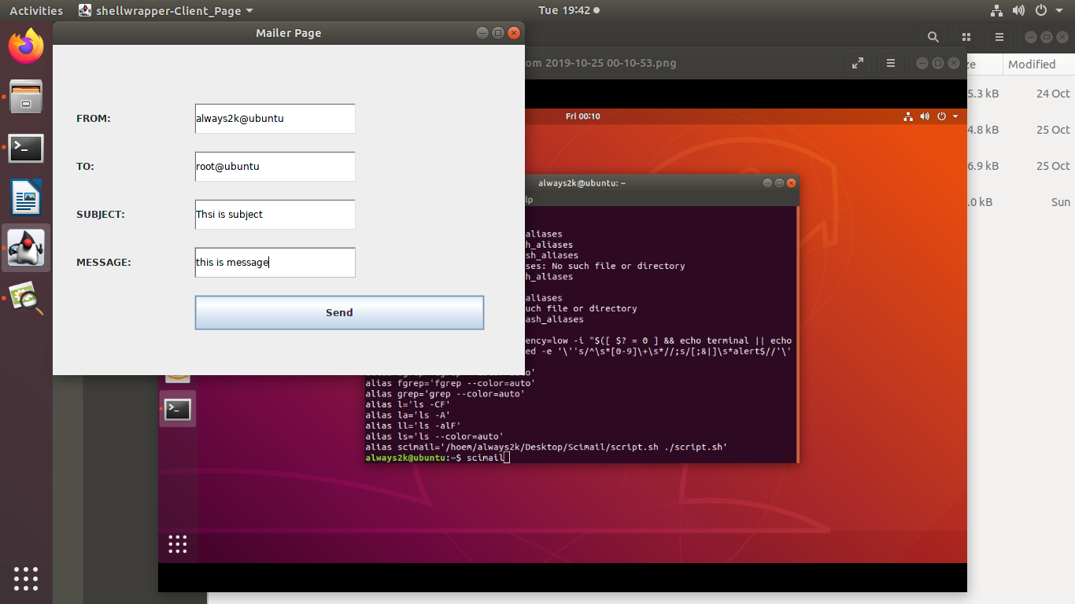
Fig 8: Java AWT interface

Slide 22
Fig 9: Mail sent via Postfix (using SMTP)

Slide 23
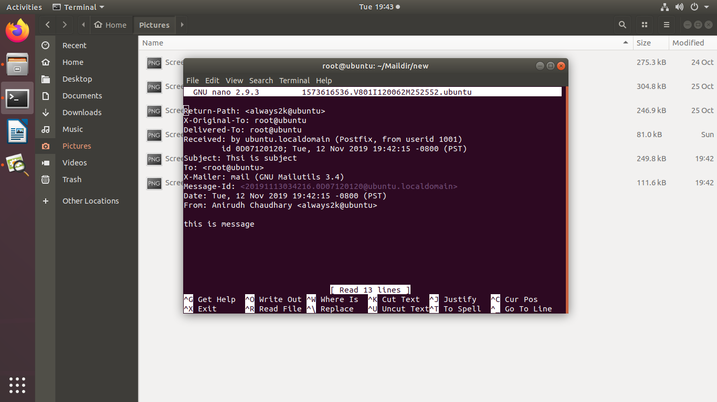
Fig 10: Mail Received via postfix

Slide 24
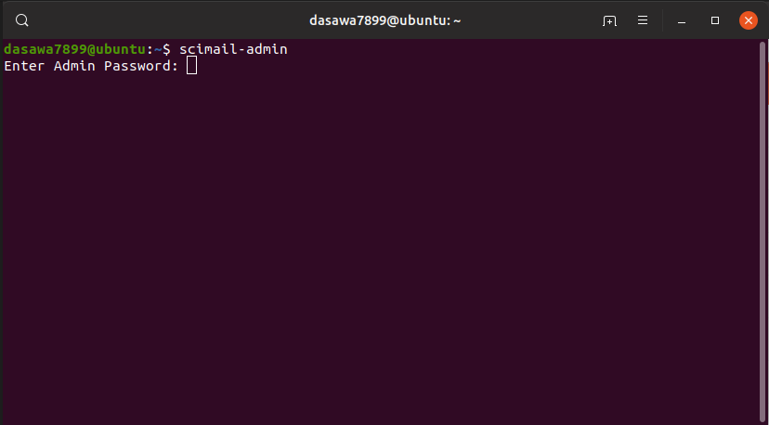
Fig 10: Mail Received via postfix

Slide 25
SCIMAIL-ADMIN WORKFLOW
Fig 1: Execution of scimail-admin alias, requests for admin authorization.

Slide 26
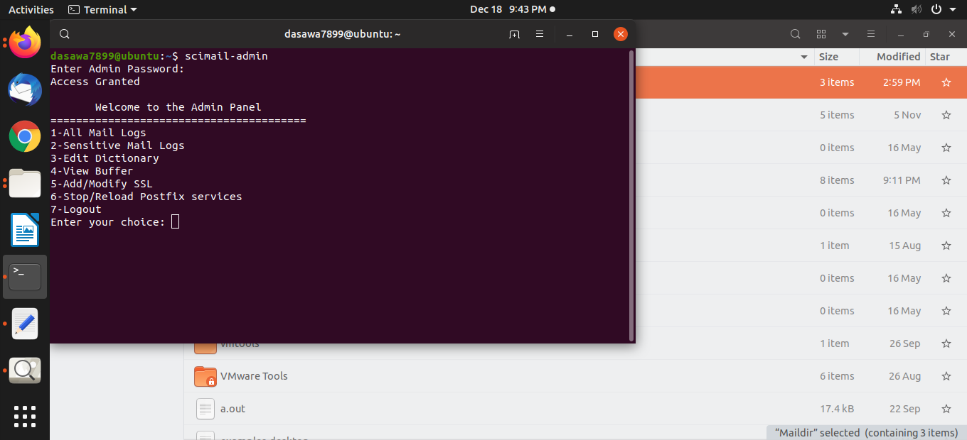
Fig 2: If access granted, Admin receives a panel for operating.

Slide 27
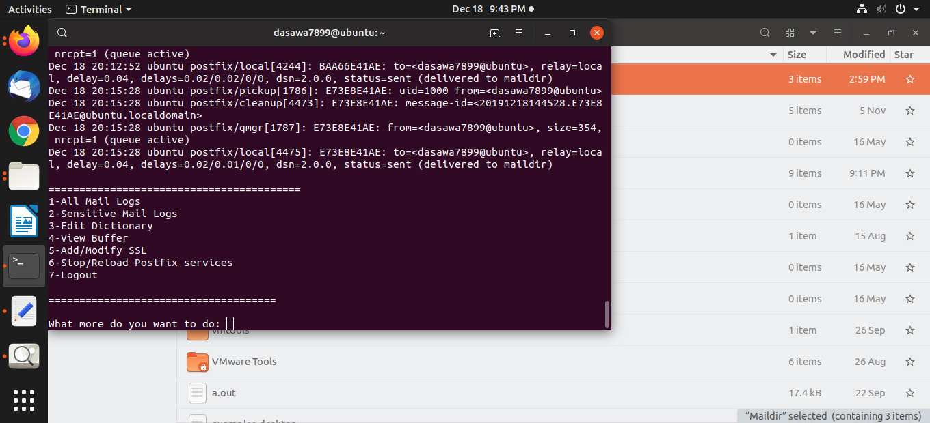
Fig 3: If admin chooses ‘1’ for viewing ‘All Mail Logs’,
Logs for sending of mails are displayed.

Slide 28

Fig 4: If the admin chooses option ‘2’ for viewing ‘Sensitive Mail Logs’,
Logs for sending of flagged emails are displayed.

Slide 29
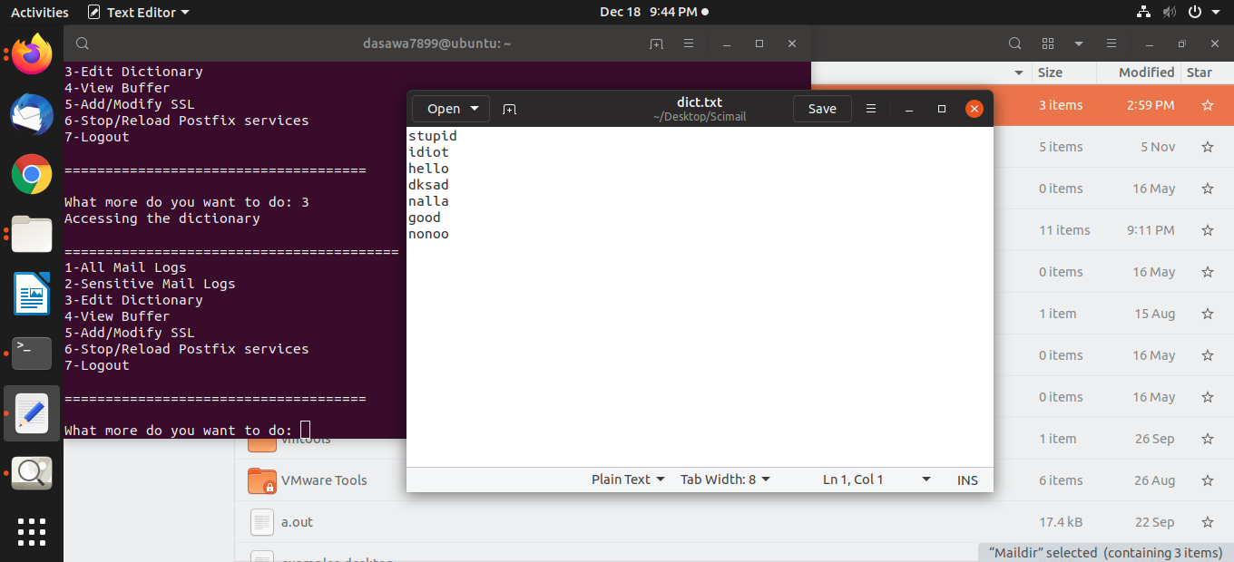
Fig 5: If the admin chooses the option ‘3’ i.e. ‘Edit Dictionary’,
Dictionary opens up in a text editor with access to read and write.

Slide 30
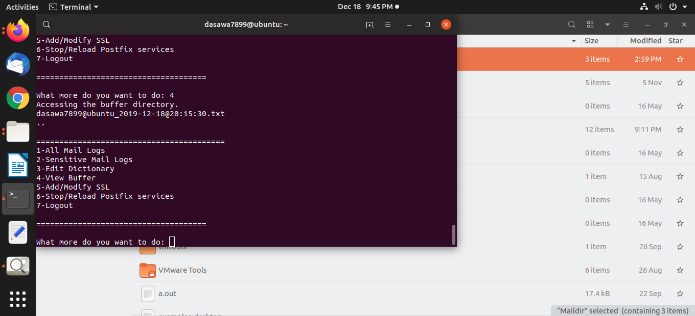
Fig 6: If the admin chooses the option ‘4’ i.e. ‘View Buffer’,
The names of the flagged mails present in the buffer directory are displayed.

Slide 31

Fig 7: If the admin chooses to operate on postfix services
And selects the option ‘6’, admin is provided with 4 different options.

Slide 32
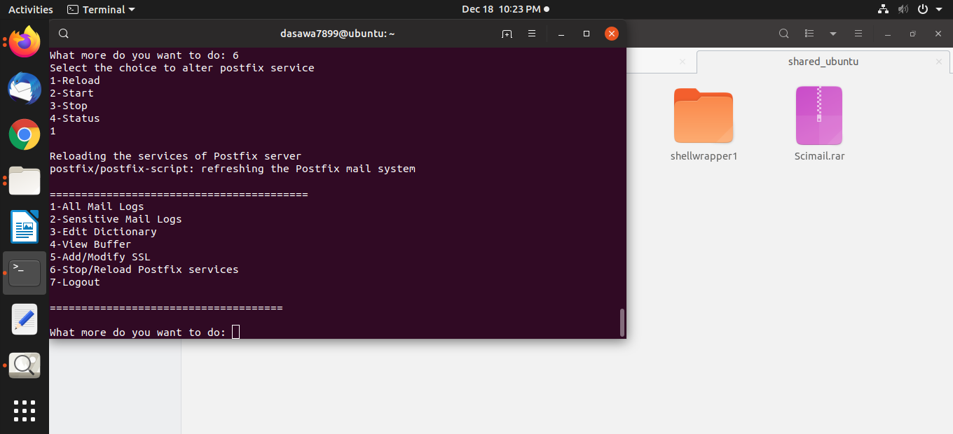
Fig 8: If the admin wishes to ‘Reload’ the postfix services and selects the option ‘1’,
After selecting the option ‘6’ in the main panel.

Slide 33

Fig 9: If the admin wishes to ‘Start’ the postfix services and selects the option ‘2’,
After selecting the option ‘6’ in the main panel.

Slide 34

Fig 10: If the admin wishes to ‘Stop’ the postfix services and selects the option ‘3’,
After selecting the option ‘6’ in the main panel.

Slide 35

Fig 11: If the admin wishes to check ‘Status’ of the postfix server then
admin selects the option ‘3’,
After selecting the option ‘6’ in the main panel.

Slide 36
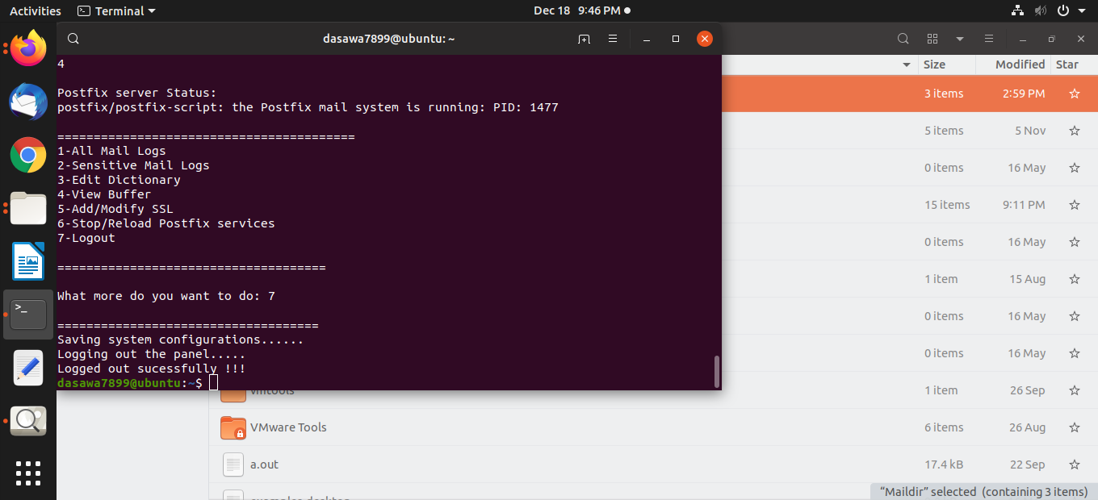
Fig 12: After the work is complete, Admin can simple select the option ‘7’
To logout from the panel and the entire respective configuration will be saved.

Slide 37
Fig 12: After the work is complete, Admin can simple select the option ‘7’
To logout from the panel and the entire respective configuration will be saved.

Slide 38
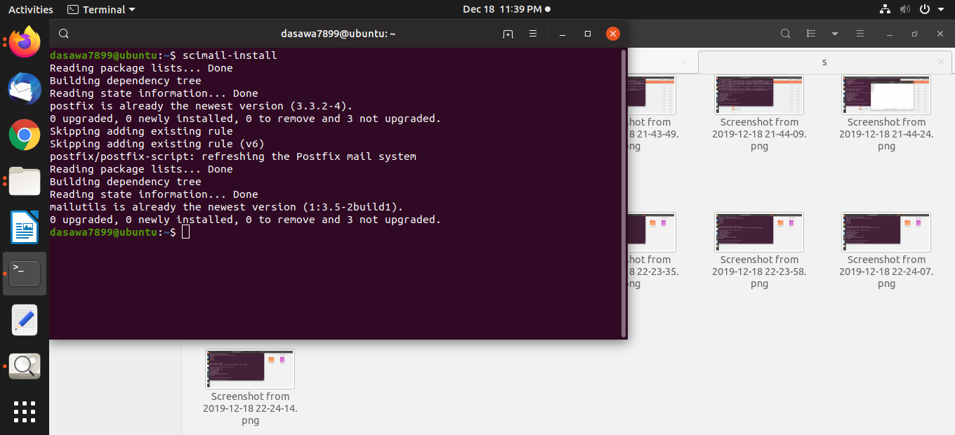
SCIMAIL-INSTALL WORKFLOW
Fig 1: Scimail-install execution when postfix is already installed and running.

Slide 39
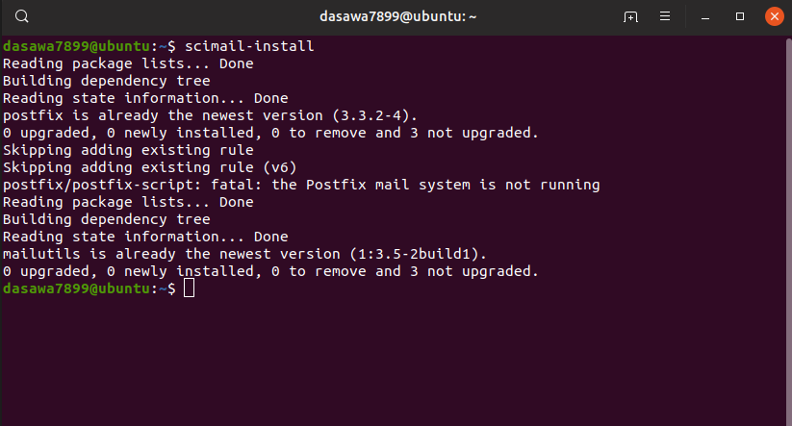
Fig 2: Scimail-install execution when postfix is already installed and not running.

Slide 40
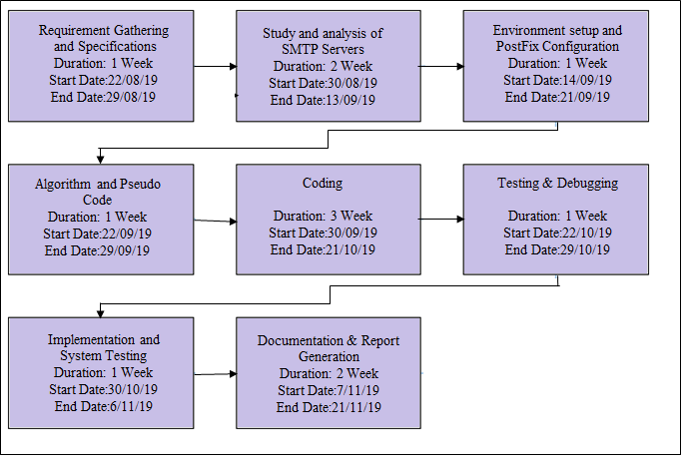
Pert Chart
Fig 3: PERT chart for the minor project

